Slide 1



Major Project
Object Detection From CCTV
Guided By : Prof. Samyak Shah
Presented By : Vinamra Gupta
Date : 24/5/2024

Slide 2
Nirma University Institute of Technology
Department of Electrical Engineering
EE801: Major Project
Roll No: 20bee129
Name of the student: Vinamra Gupta
Personal Email ID: vinamragupta121@gmail.com Mobile: 8955793138
Check-list
Sr.
Content
Tick
No.
(YES/NO/NOT APPLICABLE)
1.
The student has submitted a hard copy of the Summer Internship Certificate (completed in Sem. VII) to the panel members and also uploaded it on the Google Classroom.
yes
2.
The student has submitted a hard copy of the Internship Offer Letter (Major Project of Sem. VIII) to the panel members (applicable to industry projects only) and also uploaded it on Google Classroom.
Not applicable
3.
The student has submitted the Final Project Report in the prescribed format to the panel members in hard copy and also uploaded it on Google Classroom.
yes
4.
The student has submitted the Plagiarism Report generated by Turnitin for the project report to the panel members and the similarity is below 20 % and also uploaded it on Google Classroom.
yes
5.
The Feedback Form from the Industry Guide is filled by the industry guide in the shared Google form (OR uploaded the scanned copy of it).
Not applicable
6.
The student has submitted a copy of the Internship/Project Completion Certificate (UG EE Sem VIII) from the industry in hard copy (wherever applicable) to the panel members and also uploaded it on Google Classroom. Those students whose internship will be completed after May 24, 2024, have to upload it on Google Classroom immediately upon receiving the certificate from their industry. Also, they have to come to the department and paste it on the blank page kept in the report.
Not applicable
7.
The student has registered on ‘AlmaConnect’ and uploaded a snapshot of his AlmaConnect page on Google Classroom.
yes
8.
The student has submitted the Contact Details and Email addresses of his/her own and his/her parents in the shared Google Form.
yes

Slide 3
9.
The student has submitted a hard copy of the Job Offer Letter/Email confirmation from III Cell or Company to the panel members and uploaded the soft copy on Google Classroom.
yes
10.
The student has included the screenshot of the Exit Survey/Survey Filled on MIS in the Major Project Presentation slide.
yes
11.
The student has submitted the hard copies of the Score-Cards of GATE/CAT/GRE/TOEFL/ IELTS etc. (all wherever applicable) to the panel members and uploaded the soft copy on Google Classroom.
Not applicable
12.
The student has submitted the hard copies of the Admission Letter of National/Foreign Universities for higher studies to the panel members (wherever applicable) and uploaded the soft copy on Google Classroom.
Not applicable
13.
If the student is joining a family business/starting their own business, a student has submitted the hard copy of any one of the below documents: Certificate of Incorporation of the Company/GST registration certificate of the company, to the panel members and also uploaded it on the Google Classroom.
Not applicable
14.
The student has submitted the hard copies of the certificate(s) received for his/her community service project and also uploaded them on Google Classroom.
yes
15.
The student has submitted the hard copies of the certificate(s) received for his curricular, extra-curricular, and co-curricular activities. For example, MOOC certificate(s), NCC certificate, NSS certificate, winning/ranking in competitions etc.
Not applicable
16.
The student has submitted the conference/journal paper (if any) based on his/her work to the panel members.
Not applicable
17.
Is the work worth attempting for patent registration?
No

Slide 4
Table of Contents
Introduction to Object Detection
Preparing the dataset and annotation for training
Overview of OpenCV, YOLOv5, and Darknet
Fine-tuning the pre-trained YOLO model
Training the YOLO model using darknet
Testing the trained model on images and videos
Real Time Speed Detection with YOLOV8
Data Analysis in Real-time speed detection
Statistical Analysis if traffic Patterns
Challenges and Limitations
Conclusion and Future Directions

Slide 5
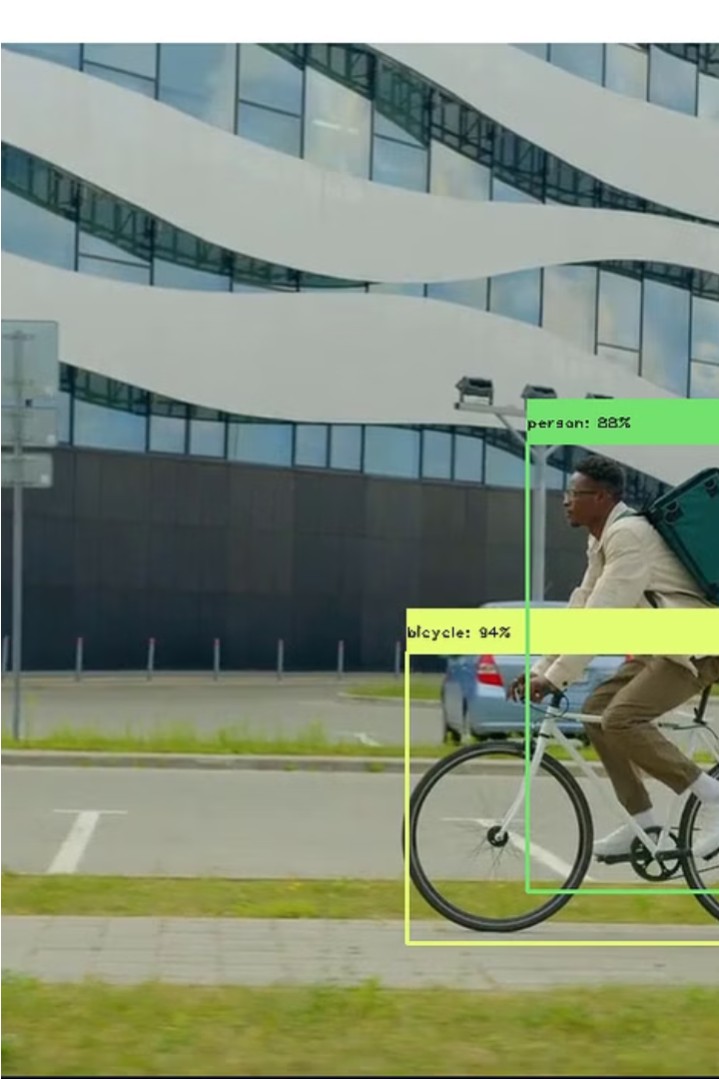
Introduction to Object Detection
Object detection is a computer vision task that involves identifying and locating objects of interest within an image or a video. Unlike image classification, which assigns a single label to an entire image, object detection provides a more detailed analysis by detecting and delineating individual objects. This technology plays a crucial role in various applications, ranging from autonomous vehicles and surveillance systems to image and video analysis.
Object detection using OpenCV ,YOLOv5 and Darknet. We detected over 20 objects from scratch and significantly improved efficiency.

Slide 6
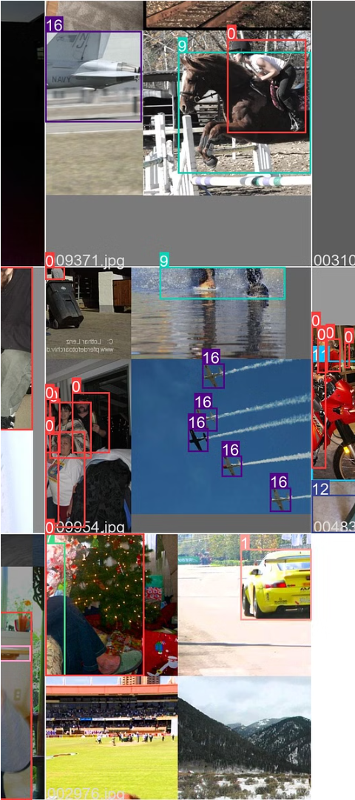
Preparing the dataset and annotations for training
Data Collection
Annotation Process
Collect relevant images and videos for the dataset in High Definition quality with minimum 500×500 pixels
Annotate objects of interest in the images and videos and put in separate folder and obtain .XML file for details
Data Preprocessing
Prepare and clean the dataset for training and separating training and testing folder with ratio of 80:20.

Slide 7
Overview of OpenCV, YOLOv5, and Darknet
OpenCV
YOLOv5
Darknet
OpenCV is a powerful open-source computer vision and machine learning software library, offering various tools for real-time computer vision. It provides a wide range of functions for image processing, including image recognition, object detection, and tracking.
YOLOv5 is an advanced open-source object detection model that stands for "You Only Look Once." It offers state-of-the-art object detection capabilities, with impressive speed and accuracy. YOLOv5 is known for its efficient architecture and ease of use for real-time inference.
Darknet is an open-source neural network framework written in C and CUDA. It is the framework behind the YOLO (You Only Look Once) family of object detection models, including YOLOv5. Darknet allows for high-speed GPU processing and efficient object detection on a wide range of devices.

Slide 8
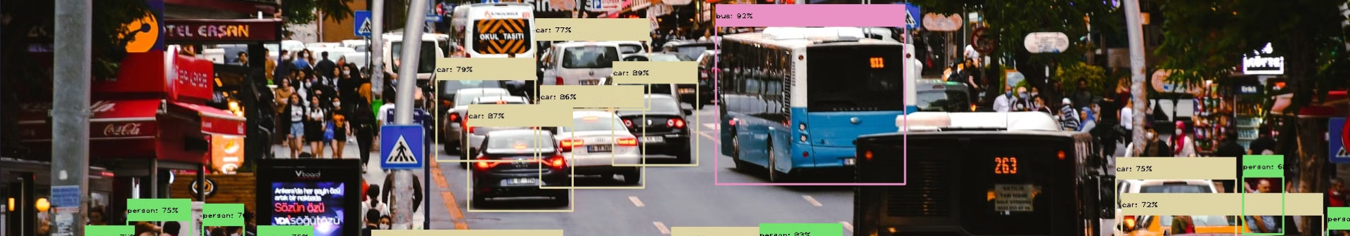
Fine-tuning the pre-trained YOLO model for better accuracy
Optimizing hyperparameters: Adjusting learning rate, batch size, epochs and momentum.
Data augmentation: Introducing variations to training data like rotation and zoom.
Transfer learning: Utilizing knowledge from pre-trained models to improve performance.
Optimized Learning : Experiment with learning rates during fine-tuning. Consider lower rates to ensure gradual adjustments to pre-trained weights.
Iterated for Improvement: Fine-tuning is an iterative process. If performance is unsatisfactory, repeat the procedure by tweaking hyperparameters, acquiring more data, or adjusting network architecture. To iterate it I have set the epoch to 50.

Slide 9
Training the YOLO model using Darknet
Initialized with paths to an ONNX model and a YAML file containing class information, the class leverages OpenCV functions for optimal model loading.
The core predictions method transforms input images into a square array for uniform processing, passes them through the YOLO model, and refines predictions using non-maximum suppression. Bounding box coordinates, class probabilities, and IDs are extracted and annotated onto the image for a clean visual representation.
The class also includes a generate_colors method for assigning unique colors to classes, enhancing visual output. In essence, YOLO_Pred offers a straightforward and effective solution for real-time object detection with the YOLO algorithm.

Slide 10
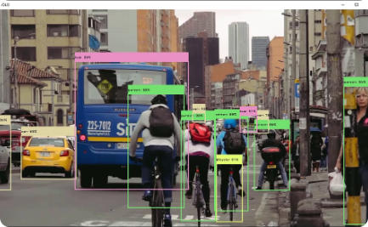
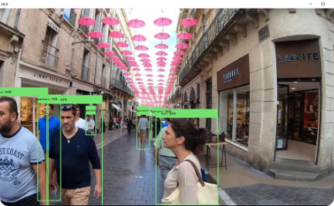
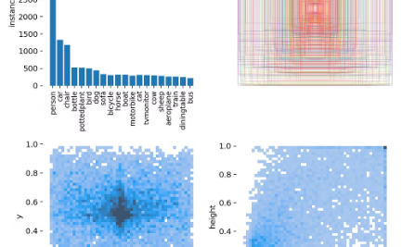
Testing the trained model on images and videos
Precision in Crowded Environments
Real-time Detection in Dynamic Environments
Robust Performance in Challenging Conditions
The trained model accurately detects multiple objects in busy urban settings, showcasing strong performance in complex scenarios.
Efficiently identifies and tracks objects in rapidly changing and diverse lighting conditions, ensuring dependable real-time performance.
Demonstrates robust detection capabilities in adverse weather scenarios, maintaining accuracy under varying natural lighting conditions.

Slide 11
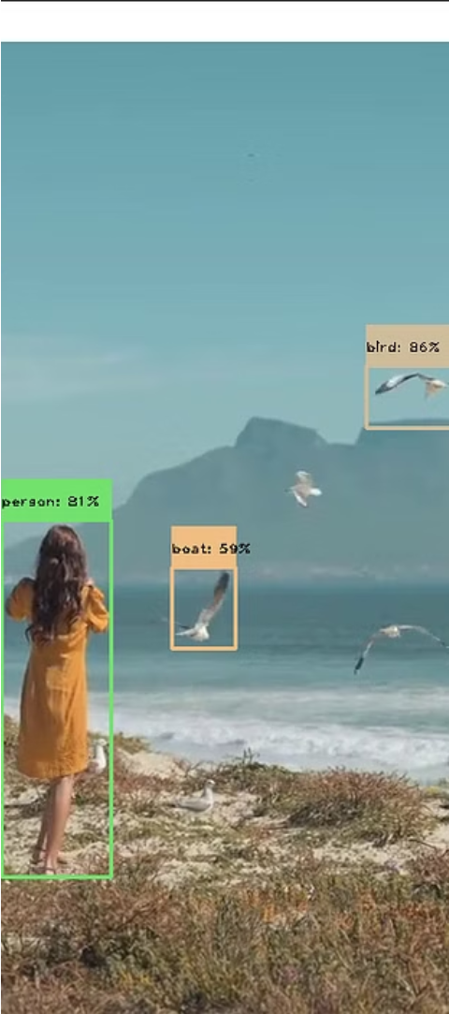
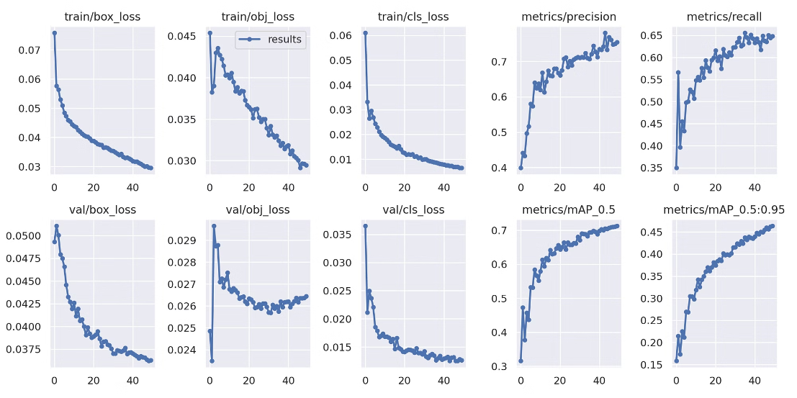
Results:
Comprehensive Detection
Enhanced Efficacy
The model accurately identifies and localizes more than 12 different objects in various settings.
Improved efficiency and speed in detecting.It is giving the precision of 70% initially but getting 86% after fine tuning and adjusting epochs.

Slide 12

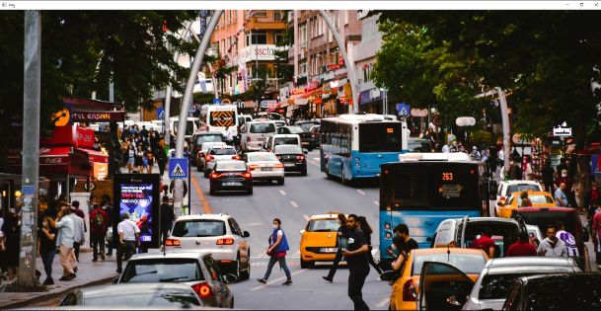
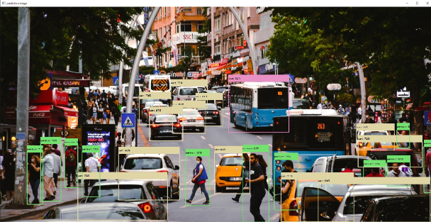
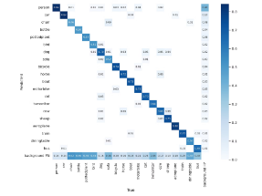
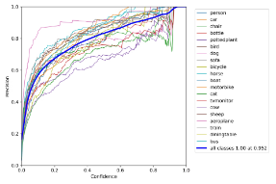
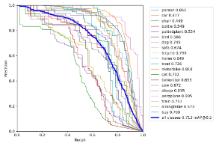
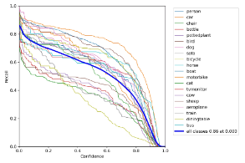
Raw Image
Final Image
Some Curves and Graphs
P Curve
PR_Curve
R Curve
Confusion Matrix

Slide 13
Real-time Speed Detection with YOLOv8
Experience the power of YOLOv8 in accurately detecting and tracking vehicle speeds in real-time. With advanced object detection algorithms, our system provides precise speed measurements for efficient traffic monitoring and management. Discover how YOLOv8 revolutionizes speed detection for improved safety and traffic control.
Method:
Input video frames are fed into the YOLOv8 model.
The model performs object detection and identifies vehicles in each frame and coordinates are recorded.
Using the 2 line we calculate time to travel between them, the distance traveled by each vehicle is calculated.
By analyzing the time difference between consecutive frames, the speed of each vehicle is determined.
The speed information is then displayed or recorded for further analysis and monitoring.

Slide 14
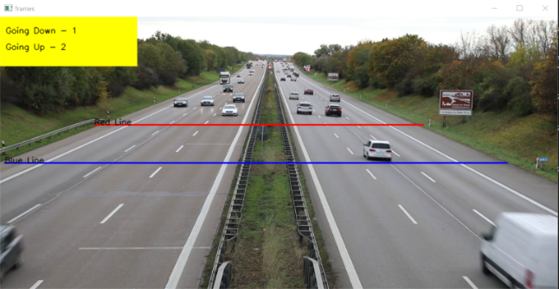
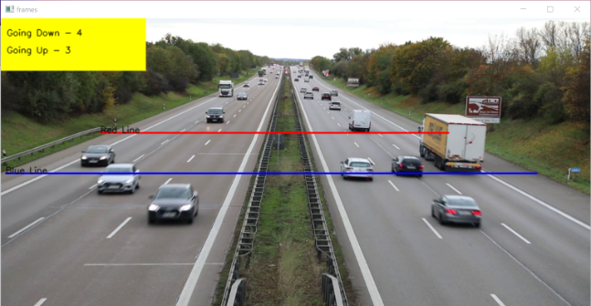
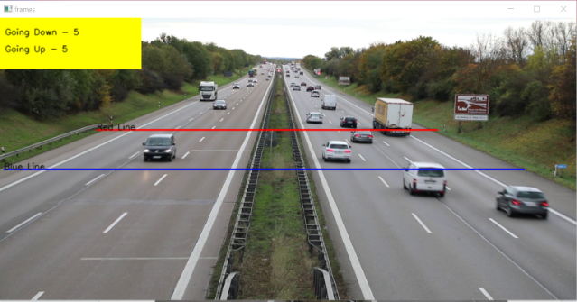

Slide 15
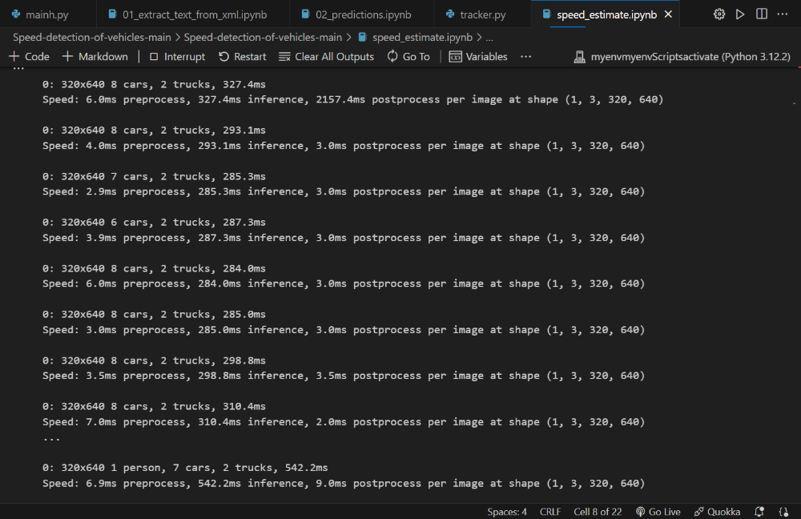
Data Analysis on Real-time Speed Detection
We used YOLO to process the data and stored it in lists for both sides of the highway. We collected traffic data at fixed intervals to compare which periods had more or less traffic. We divided the video data into morning and whole day segments, and compared the data of both lanes. We found that downtime for the whole day was lower than during the morning, and plotted it in a graph. We also tracked traffic data for uptime and downtime in the morning and plotted it on a bar chart to determine which side had more traffic. We analyzed over speeding by tracking it and putting it in a list for both lanes, and then calculated the percentage of over speeding vehicles vs total vehicles passed on both sides.

Slide 16
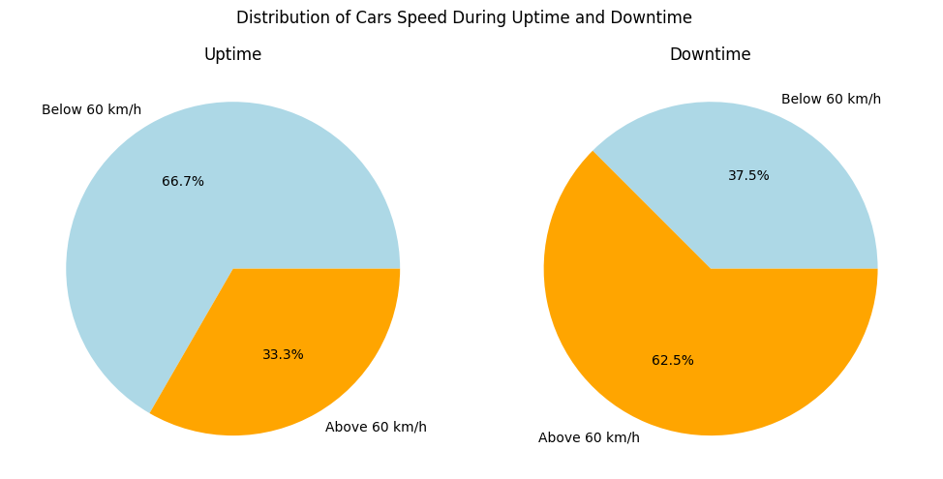
Statistical Analysis of Traffic Patterns
In this analysis, we performed statistical tests to identify significant variations in traffic patterns based on different factors, such as time of day, day of the week, and weather conditions. We used techniques to determine if there were any statistically significant differences in traffic volume and speed. The results provide valuable insights for traffic management and planning.

Slide 17
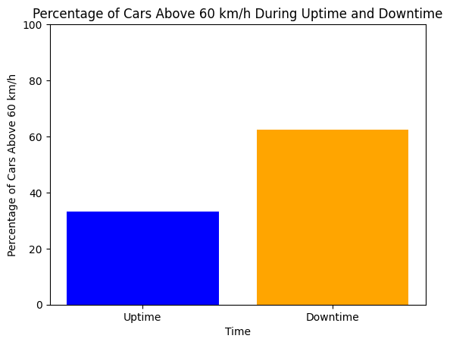
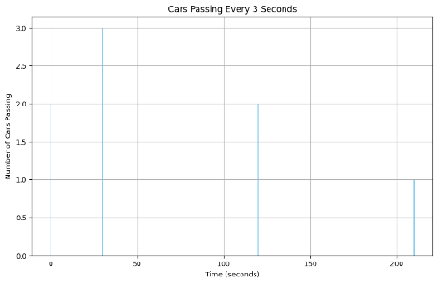
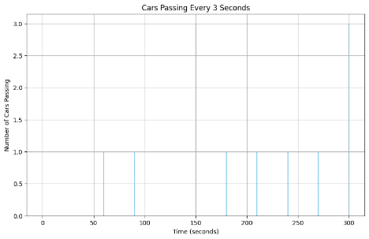
Over Speeding on both sides of highway in whole day
Traffic Flow in morning v/s Traffic Flow in whole day

Slide 18
Challenges and Limitations
Training an object detection model can be time-consuming and computationally intensive.
Optimizing hyperparameters for better accuracy requires extensive experimentation and expertise.
Addressing class imbalance and data augmentation challenges the training process.
Fine-tuning for complex environmental conditions and diverse object characteristics is crucial.
Ensuring real-time performance on resource-constrained devices remains a significant challenge.

Slide 19
Conclusion and Future Directions
In summary, this project has successfully developed an advanced intelligent object detection system for analyzing CCTV footage. By employing state-of-the-art computer vision techniques, the system enhances surveillance efficiency and addresses various security and monitoring needs.
Future Scope:
Looking ahead, potential future directions for this project include:
Integration with Smart City Initiatives
Expanding real-time analytics capabilities
Investigating edge computing deployment
Developing user-friendly interfaces
Establishing partnerships with law enforcement agencies
By pursuing these avenues, the system can contribute to safer and more efficient urban environments.

Slide 20
THANK YOU!

